Slide 1

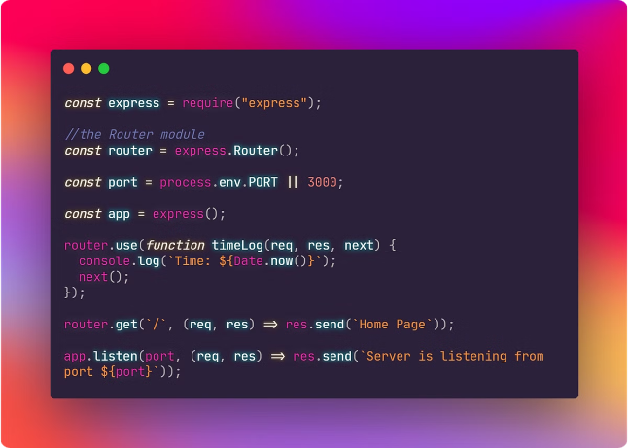


Introduction to Error Handling in Express.js
Error handling is a critical aspect of building robust and reliable web applications with Express.js. This presentation will guide you through the importance of error handling, the types of errors you may encounter, and the best practices for managing them effectively.
by Vivek Singh Parmar

Slide 2
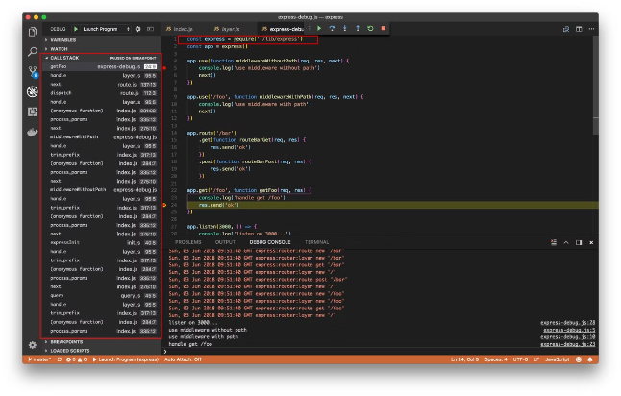
Importance of Error Handling
1
Improved User Experience
2
Easier Debugging
Effective error handling makes it simpler to identify and resolve issues, saving time and resources during the development process.
Proper error handling ensures users are provided with clear and helpful feedback, enhancing their overall experience with your application.
3
Compliance and Security
Handling errors correctly can help you avoid exposing sensitive information and maintain compliance with relevant regulations.

Slide 3
Types of Errors in Express.js
Synchronous Errors
Asynchronous Errors
Middleware Errors
These occur during the execution of synchronous code, such as database queries or file operations.
These happen in the context of asynchronous operations, like API calls or file uploads.
Errors can occur within middleware functions, which need to be handled appropriately.

Slide 4


Handling Synchronous Errors
1
Try-Catch Blocks
Wrap your synchronous code in try-catch blocks to handle errors gracefully.
2
Error Objects
Capture and inspect the error object to get detailed information about the issue.
3
Respond with Appropriate Status Codes
Send relevant HTTP status codes to provide meaningful feedback to the client.

Slide 5


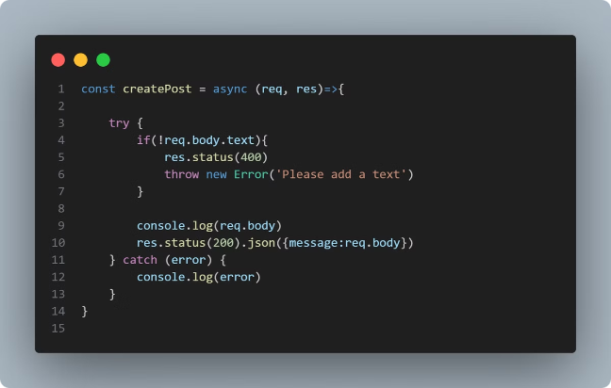


Handling Asynchronous Errors
Promises and Async/Await
Use Promise.catch() or try-catch with async/await to handle asynchronous errors.
Error-First Callbacks
In traditional Node.js callbacks, the first argument is reserved for the error object.
Event Emitters
Listen for the 'error' event emitted by event-driven modules and handle accordingly.

Slide 6

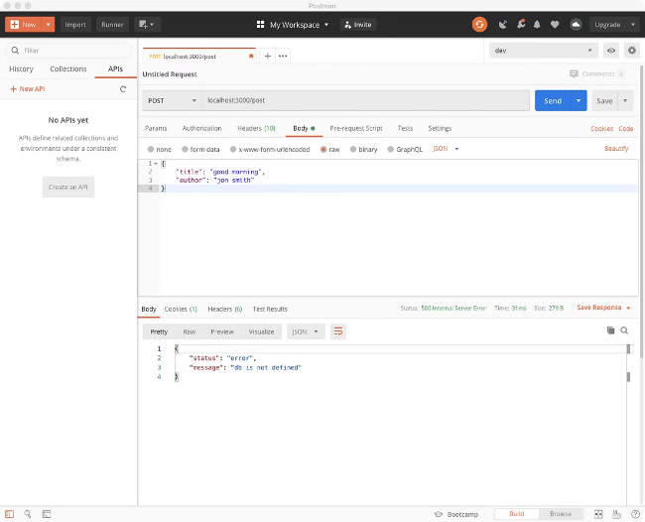
Middleware for Error Handling
The Error-Handling Middleware
Customizing Error Responses
Express provides a built-in error-handling middleware to capture and manage errors.
You can customize the error response to provide more detailed information to the client.
Centralized Error Handling
Error Logging and Monitoring
Using a centralized error-handling middleware can simplify error management across your application.
Integrate error logging and monitoring tools to gain visibility into your application's health.

Slide 7




Custom Error Handling
Error Classes
Create custom error classes to represent different types of errors in your application.
Error Middleware
Implement custom error-handling middleware to handle your application-specific errors.
Error Transformation
Transform errors into a standardized format to ensure consistency in error responses.

Slide 8


Best Practices and Recommendations
Avoid Revealing Sensitive Information
Ensure that error messages do not expose sensitive details that could compromise security.
Provide Meaningful Error Messages
Craft error messages that are informative and helpful for both developers and users.
Implement Consistent Error Handling
Apply a consistent approach to error handling throughout your entire Express.js application.
Integrate Error Monitoring
Use error monitoring tools to gain visibility into your application's health and performance.

Slide 9
Error Handling refers to how Express catches and processes errors that occur both synchronously and asynchronously. Express comes with a default error handler so you don’t need to write your own to get started.

